Slide 1
Tailored Nutrition
Sanjeev Sharma, Andrew , Leon Campbell,
Advnc apl:cpstme maj csci 49900
2-24-18

Slide 2
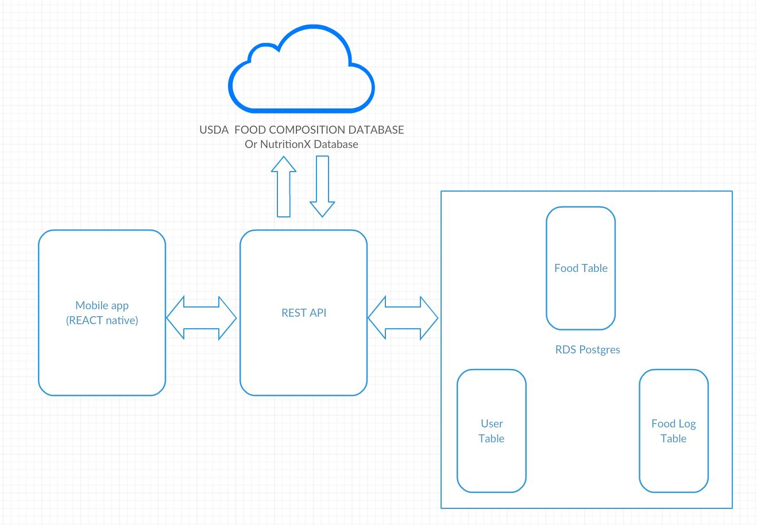
Architecture

Slide 3
Flow

Slide 4
Flow

Slide 5
Wireframe

